Slide 1


Amazon Sales Analysis
Data driven insights on amazon’s sales performance : unveiling trends in sales, profit, and revenue across regions
Presented by Puja Reddy Poreddy

Slide 2

CONTENT
Amazon Sales Analysis :
•Introduction
•Problem Statement
•Dataset Overview
•Methodology
•Data Cleaning
•Data Analysis
•Dashboard Overview
•Key Findings

Slide 3
INTRODUCTION
OBJECTIVE : The objective of this Amazon Sales Analysis is to identify key sales trends and metrics for optimizing business performance.
TOOLS USED : The tools used for this Amazon Sales Analysis are Excel for data cleaning and Power BI for data visualization.
IMPORTANCE : This Amazon Sales Analysis is crucial for understanding consumer behavior and market dynamics, enabling informed decision-making. It helps businesses optimize sales strategies, enhance inventory management, and identify growth opportunities to drive profitability.

Slide 4
PROBLEM STATEMENT
Sales management has gained importance to meet increasing competition and the need for improved methods of distribution to reduce costs and to increase profits. Sales management today is the most important function in a commercial and business enterprise.

Slide 5
DATASET OVERVIEW
Columns:
Region: Geographic region where the sales occurred.
Country: Country where the sales occurred.
Item Type: Type of item sold.
Sales Channel: Channel through which the sale was made (e.g., online, offline).
Order Priority: Priority level of the order.
Order Date: Date when the order was placed.
Order ID: Unique identifier for the order.
Ship Date: Date when the order was shipped
Units Sold: Number of units sold in the order.
Unit Price: Price per unit of the item.
Unit Cost: Cost per unit of the item.
Total Revenue: Total revenue generated from the order.
Total Cost: Total cost incurred for the order.
Total Profit: Total profit earned from the order.

Slide 6
DATA CLEANING
TOOL : Excel
STEPS : •Removed duplicates and handled missing values.
•Standardized date formats for consistency.
•Filtered out irrelevant data to focus on meaningful insights.
•Column Manipulation:
•Replaced values in the "Order Priority" column (H -> High, L -> Low, C -> Critical, M -> Medium).
•Converted "Order Date" and "Ship Date" from text format to date format.

Slide 7


DATA ANALYSIS
TOOL: Power BI
STEPS: 1. Imported cleaned data into Power BI.
2 . Developed calculated columns and measures for key metrics.
3 . Designed interactive visuals to explore sales trends by region, product category, and time period.

Slide 8

DASHBOARD OVERVIEW
GRAPHS:
•Total Cost and Total Revenue by Region: Visual comparison of total cost and revenue across different regions.
•Total Profit by Region: Breakdown of profit figures, providing insights into which regions are most profitable.
•Units Sold by Sales Channel: Displays the distribution of units sold across various sales channels (e.g., online, retail).
•Country with Minimum and Maximum Revenue: Identifies countries with the highest and lowest revenue performance.
•Revenue Trend Over Time: Illustrates how revenue fluctuates over different time periods.
•Most Sold Items: Lists items with the highest sales volume, providing insights into customer preferences.
•Total Profit by Item Type: Displays profitability segmented by different item types.
•Year-Wise Profit and Revenue: Tracks profit and revenue trends year over year for long-term analysis.
•Month-Wise Sales Analysis: Offers a detailed breakdown of sales figures on a monthly basis.
•Sum of Total Profit by Order Priority: Shows total profit categorized by different order fulfillment priorities.
•Year and Month-Wise Sales: Provides a comprehensive overview of sales trends by both year and month.
KEY PERFORMANCE INDICATORS (KPIs):
•Maximum Unit Price: Displays the highest selling price for units sold.
•Minimum Unit Price: Shows the lowest selling price for units sold.
•Total Revenue: Represents the overall income generated from sales.
•Total Profit: Indicates the net profit after deducting costs from revenue.
•Total Cost: Captures the overall expenditure related to sales.
•Sales : Displays the total number of sales

Slide 9
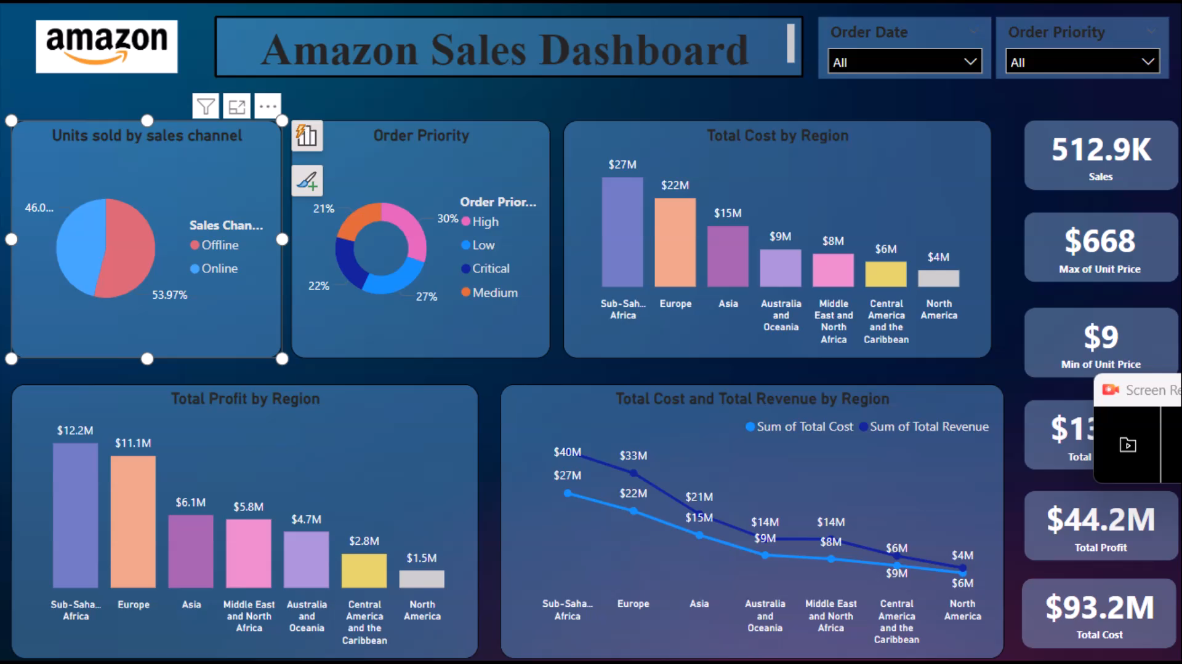
AMAZON SALES PERFORMANCE DASHBOARD VIDEO:

Slide 10
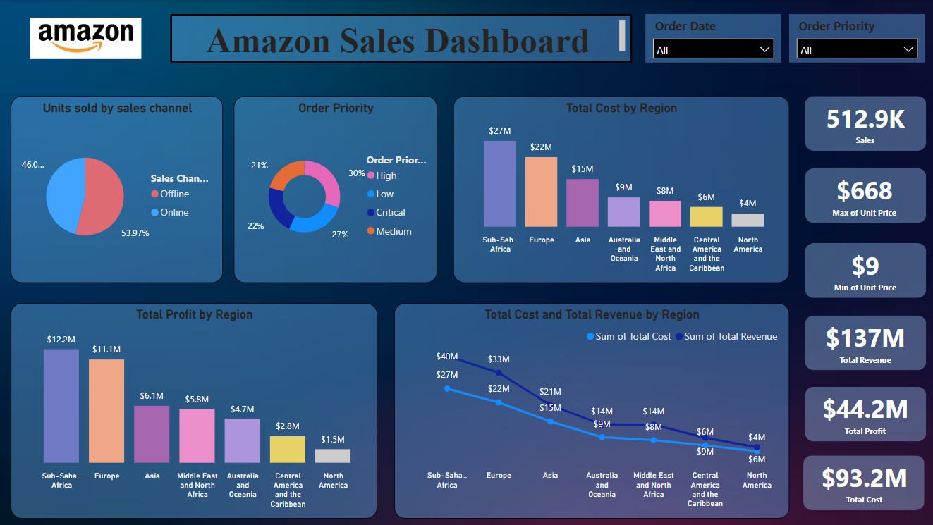

Slide 11
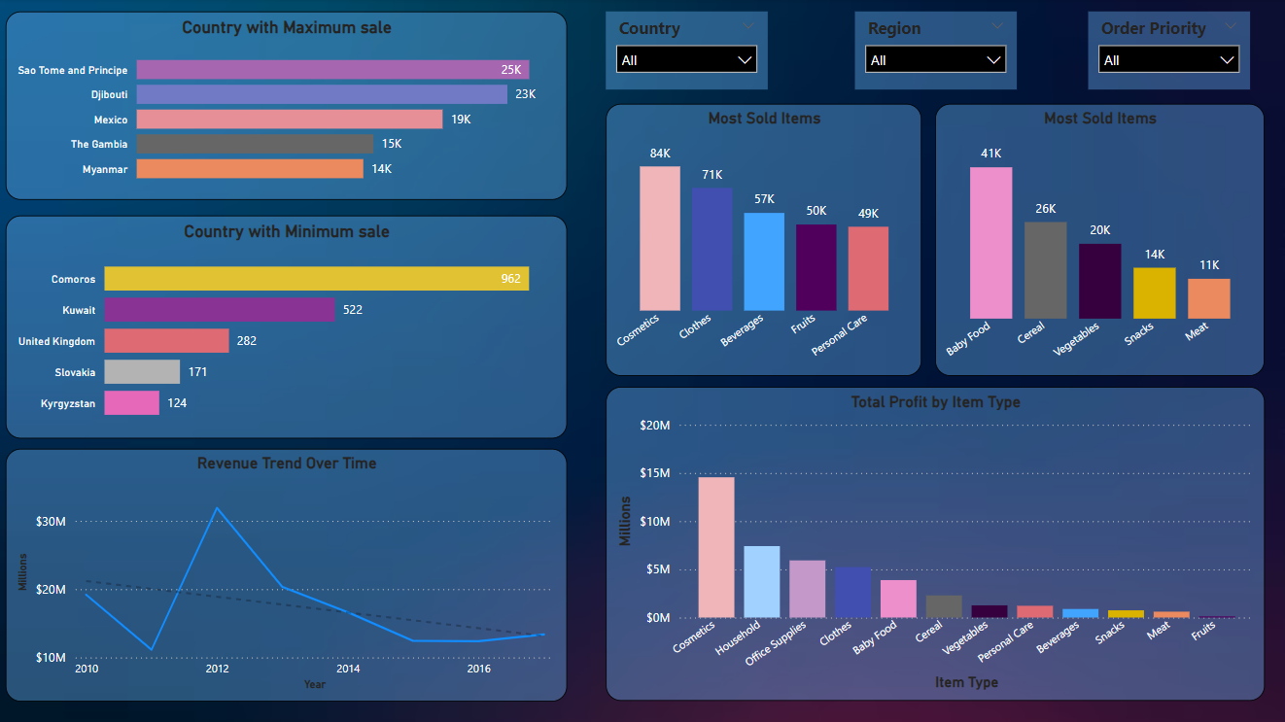

Slide 12
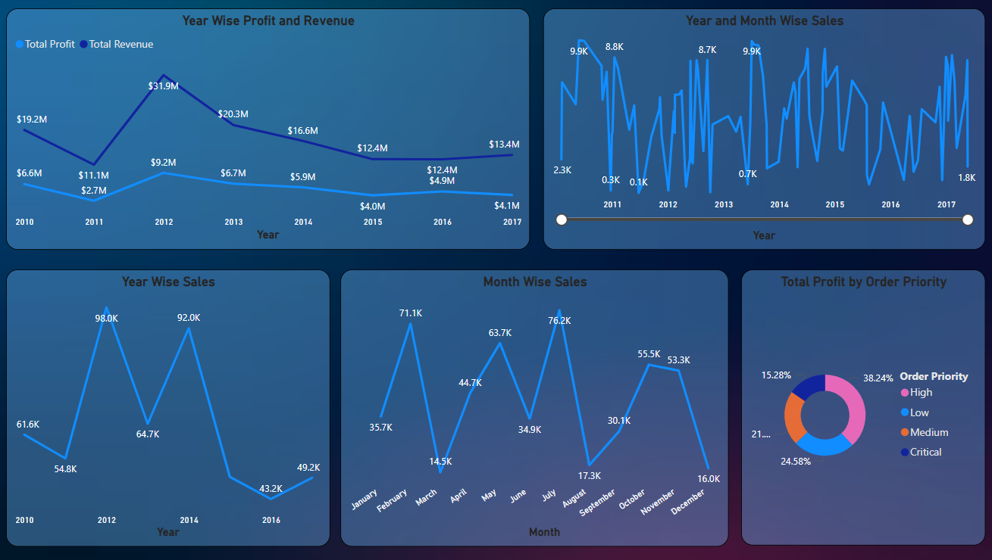

Slide 13
KEY FINDINGS :
Total Revenue: The total revenue generated is $137 million, indicating robust sales performance across various regions.
Profit by Region: Sub-Saharan Africa generates a total profit of $12.2 million, indicating strong market performance in this region.
Sales Channel Effectiveness: Offline sales channels account for 53.97% of total sales, outperforming online sales channels and highlighting consumer preference for in-person shopping experiences.
Top Country by Maximum Sales: The country with the maximum sales is Sao Tome and Principe, with $25,000 in revenue.
Most Sold Items: Cosmetics emerge as the most sold items with 84,000 units sold, driving significant revenue.
•AMAZON SALES ANALYSIS DASHBOARD GITHUB LINK :
https://github.com/PoreddyPujareddy01/Amazon-Sales-Analysis_using_powerbi.git

Slide 14

NETFLIX MOVIES AND TV SHOWS DATA ANALYSIS USING SQL
2ND PROJECT
Project Overview: Netflix Data Analysis
Objective:
The objective of this project is to analyze Netflix's extensive dataset to uncover insights related to show types, ratings, release years, directors, genres, and more. This analysis aims to provide valuable information that can help understand viewing trends and preferences among Netflix users.
Data Source:
The dataset used in this project comprises various attributes of shows available on Netflix, including titles, types (movie or TV show), ratings, release years, directors, countries, and genres.
Key Questions and SQL Queries:
Below are the key questions addressed in the project along with their corresponding SQL queries:

Slide 15
EASY:
1.What is the count of each show type (Movie, TV Show)?
SELECT type,
COUNT(*) AS count
FROM netflix
GROUP BY type;
2.What are the top 5 most common ratings on Netflix?
SELECT rating,
COUNT(*) AS count FROM netflix
GROUP BY rating
ORDER BY count DESC
LIMIT 5;
3.How many unique countries are represented in the Netflix dataset?
SELECT COUNT(DISTINCT country) AS unique_countries
FROM netflix;

Slide 16
INTERMEDIATE:
4. What are the top 5 most common release years for shows and movies on Netflix?
SELECT release_year,
COUNT(*) AS show_count
FROM netflix
GROUP BY release_year
ORDER BY show_count DESC
LIMIT 5;
5.Who are the top 5 directors with the most titles?
SELECT director,
COUNT(*) AS title_count
FROM netflix
GROUP BY director
ORDER BY title_count DESC
LIMIT 5;
6.What is the average release year by show type?
SELECT type,
AVG(release_year) AS average_release_year
FROM netflix GROUP BY type;

Slide 17

HARD:
7.What are the most common genre combinations on Netflix?
SELECT listed_in,
COUNT(*) AS count
FROM netflix
GROUP BY listed_in
ORDER BY count DESC
LIMIT 5;
8.How many shows are there per duration category (e.g., Movies by Minutes, TV Shows by Seasons)?
SELECT type, duration,
COUNT(*) AS count
FROM netflix
GROUP BY type, duration
ORDER BY count DESC;
9.Which shows were released in the latest year?
SELECT title, release_year
FROM netflix
WHERE release_year = (SELECT MAX(release_year) FROM netflix);
10.What are the top 5 countries with the most titles on Netflix?
SELECT country,
COUNT(*) AS title_count
FROM netflix
GROUP BY country
ORDER BY title_count DESC
LIMIT 5;
This Photo by Unknown Author is licensed under CC BY-SA-NC

Slide 18

•Methodology:
The analysis employs SQL queries to extract and manipulate the data, allowing for the calculation of various metrics and insights. The results are presented in a structured format, highlighting significant trends and observations.
•Tools Used:
SQL: For data extraction and querying.
•Key Findings:
The analysis reveals the distribution of show types and ratings, highlights popular genres, and provides insights into the viewing landscape across different countries and time periods. • Recommendations can be drawn for content acquisition strategies based on the trends identified.
•Project Git Hub link: https://github.com/PoreddyPujareddy01/Netflix_sql_project.git

Slide 19

ADVENTURE WORKS PROJECT USING POWER BI
3RD
PROJECT
OBJECTIVE: The objective of this Adventure Works Sales Analysis is to uncover key sales trends and performance metrics to optimize business strategies and enhance decision-making.
TOOLS USED: Power BI was the sole tool used for this analysis, enabling data cleaning, visualization, and interactive dashboard creation.
IMPORTANCE: The Adventure Works project was crucial in transforming complex data into actionable insights, providing a holistic view of business performance across regions, products, and sales channels. By leveraging Power BI, I created interactive dashboards that simplified the analysis of key metrics, enabling quick identification of profitable regions, top-selling products, and effective sales channels.

Slide 20
PROBLEM STATEMENT
In the current competitive landscape, effective sales management is essential for maximizing profitability and reducing costs. Adventure Works seeks insights into sales performance across different product categories and regions to enhance decision-making and operational efficiency. This analysis aims to identify key trends and patterns, enabling the company to refine its strategies, better serve customer demands, and drive sustainable growth in a dynamic market.

Slide 21
DATA ANALYSIS:
TOOL: Power BI
STEPS:
Imported the cleaned data into Power BI.
Created calculated columns and measures to derive key performance metrics.
Designed interactive visuals to analyze and explore sales trends across regions, product categories, and time periods.

Slide 22
DASHBOARD OVERVIEW
Graphs:
Total Cost and Total Revenue by Region:
Created a clustered column chart that visually compares the total cost and total revenue for each region (e.g., Europe, North America, Pacific).
Used different colors for cost and revenue to enhance clarity.
Total Profit by Region:
Used a bar chart to display total profit for each region, highlighting which regions are the most profitable.
You can add data labels to show exact profit values for better insight.
Units Sold by Sales Channel:
Created a pie chart or a stacked bar chart to show the distribution of units sold across various sales channels (e.g., online, retail).
This will help visualize which channel contributes most to unit sales.

Slide 23

KEY PERFORMANCE INDICATORS
Maximum Unit Price:
Displays this as a card visualization showing the highest selling price of units sold within the dataset.
Minimum Unit Price:
Another card visualization that shows the lowest selling price for units sold.
Total Revenue:
A KPI card that presents the overall income generated from all sales, helping track performance
against targets.
Total Profit:
Displays this as a KPI card that indicates the net profit after deducting costs from revenue.
Total Cost:
A KPI card that captures the total expenditures related to sales, providing insight into spending versus revenue.
Sales:
Shows this as a total count of sales, represented in a card visualization, indicating the total number of transactions mad.

Slide 24
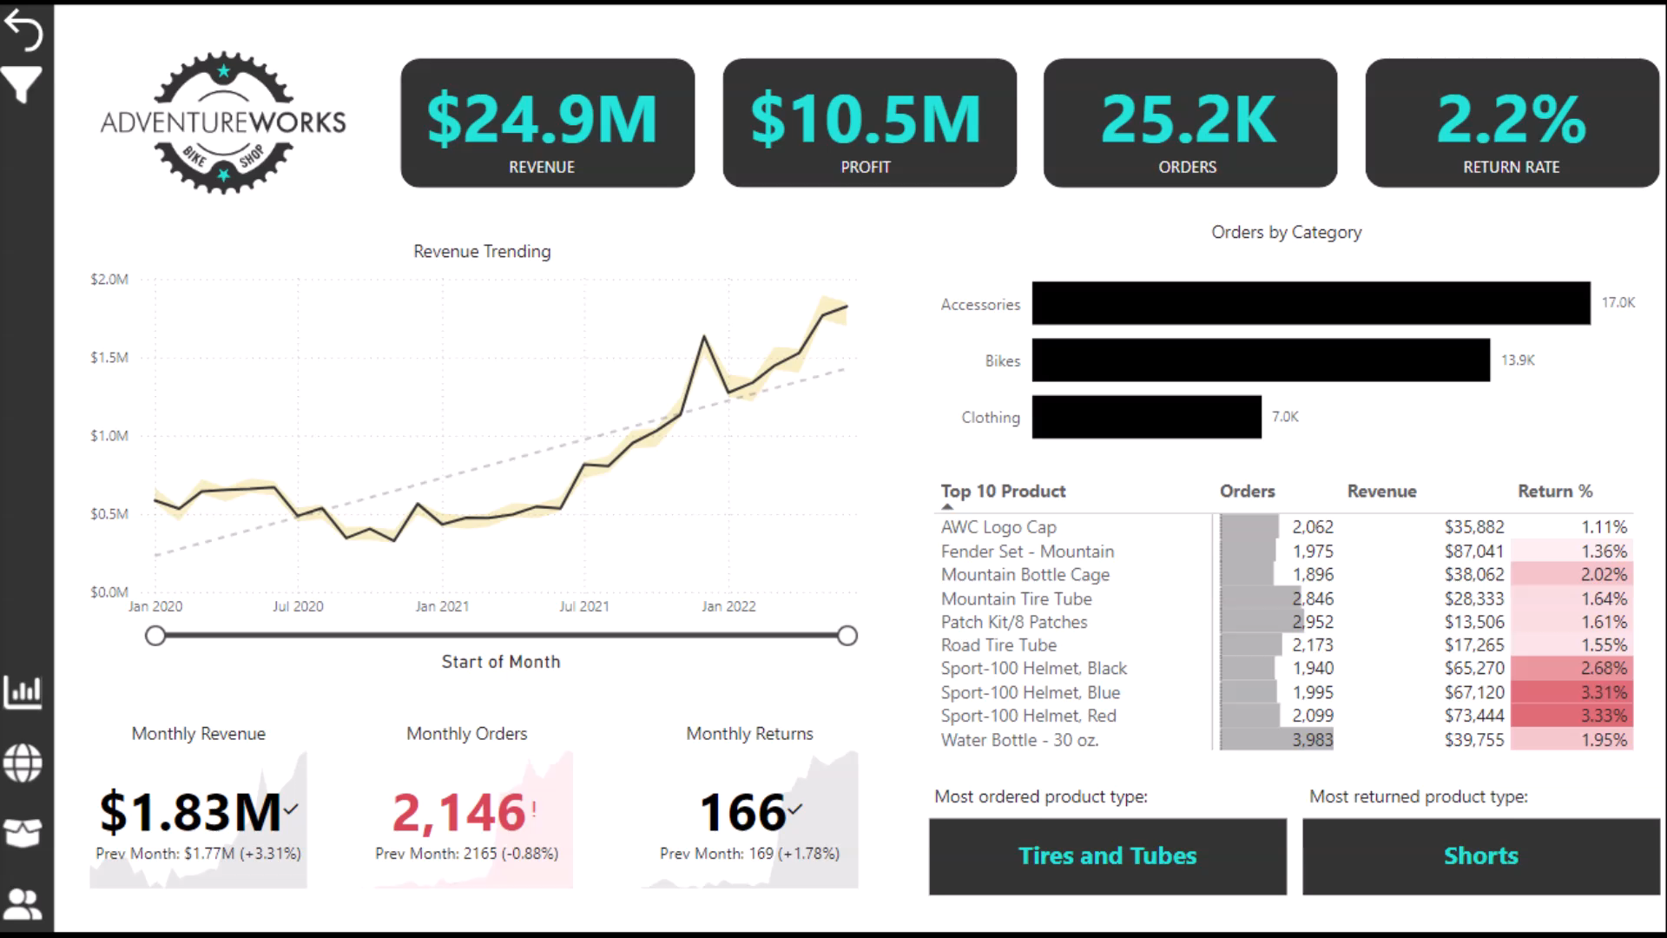
ADVENTURE WORKS DASHBOARD VIDEO :

Slide 25
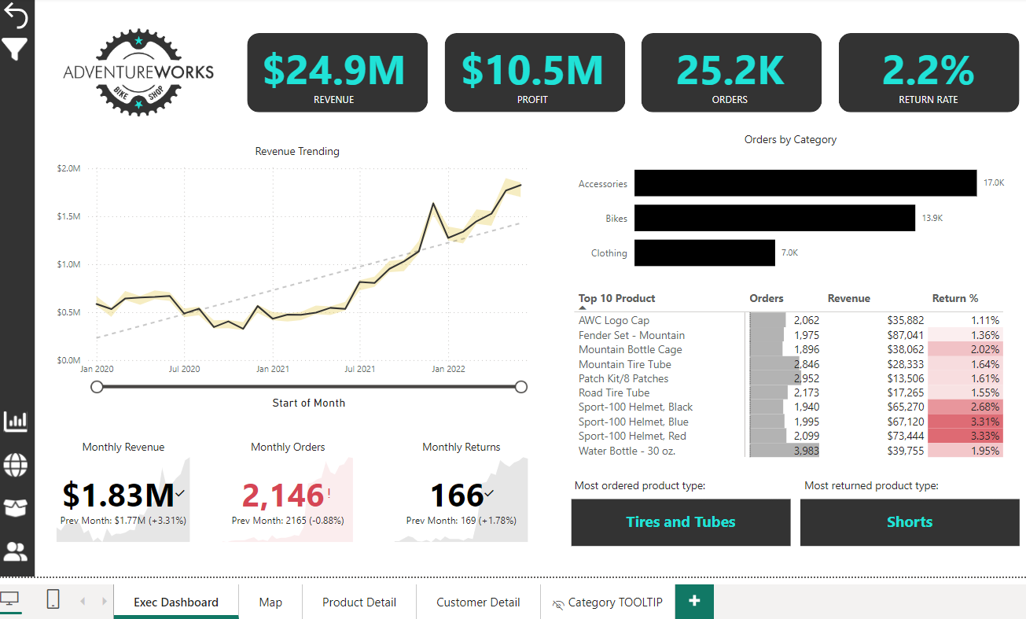

Slide 26
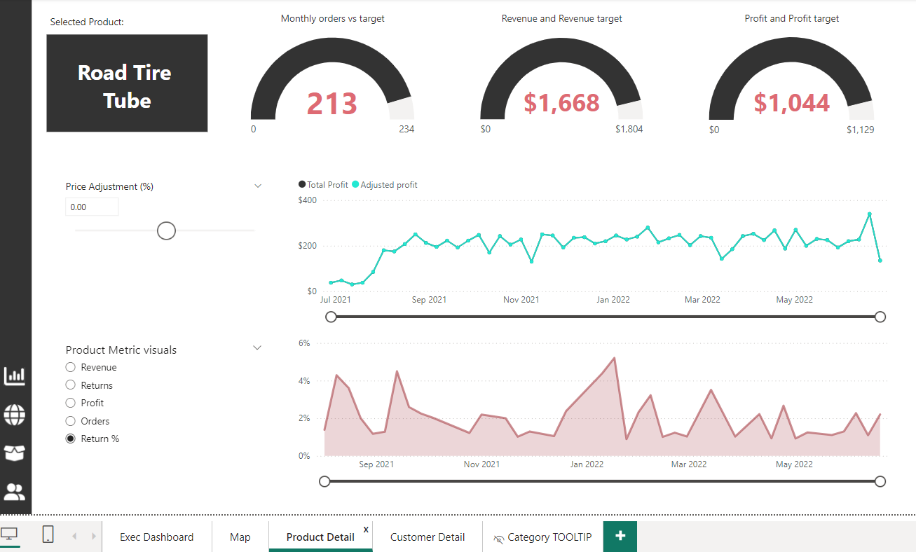

Slide 27
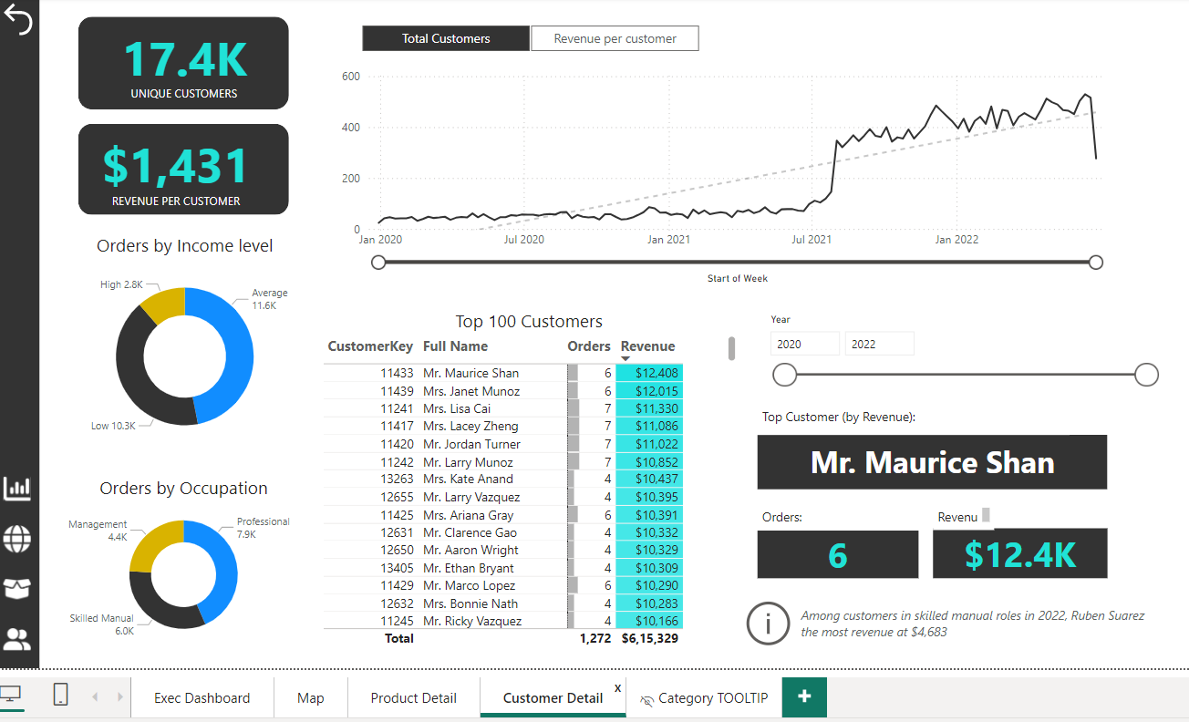

Slide 28

KEY FINDINGS
Total Revenue:
$24.9 million
Displays this as a prominent KPI card in your dashboard to highlight overall sales performance.
Total Profit:
$10.5 million
Included this as another KPI card to indicate the net profit generated.
Total Orders:
25.2K (25,200 orders)
Visualized this using a simple card or bar chart to showcase the volume of orders placed.
Return Rate:
2.2%
This can be displayed in a gauge chart or as a KPI indicator, providing insight into product return behavior.
Unique Customers:
17.4K (17,400 unique customers)
Represented this as a KPI card to indicate the breadth of your customer base.
Revenue per Customer:
$1,431
Used a card visualization to highlight how much revenue is generated per unique customer,
showcasing the value of each customer.

Slide 29
LINKS FOR 3 PROJECTS :
AMAZON SALES ANALYSIS DASHBOARD :
https://github.com/PoreddyPujareddy01/Amazon-Sales-Analysis_using_powerbi.git
2. NETFLIX MOVIES AND TV SHOWS DATA ANALYSIS USING SQL :
https://github.com/PoreddyPujareddy01/Netflix_sql_project.git
ADVENTURE WORKS PROJECT USING POWER BI :
https://github.com/PoreddyPujareddy01/Adventure_Work_Project_Using_PowerBI.git

Slide 30


